Slide 1
RFID
Radio frequency identification

Slide 2
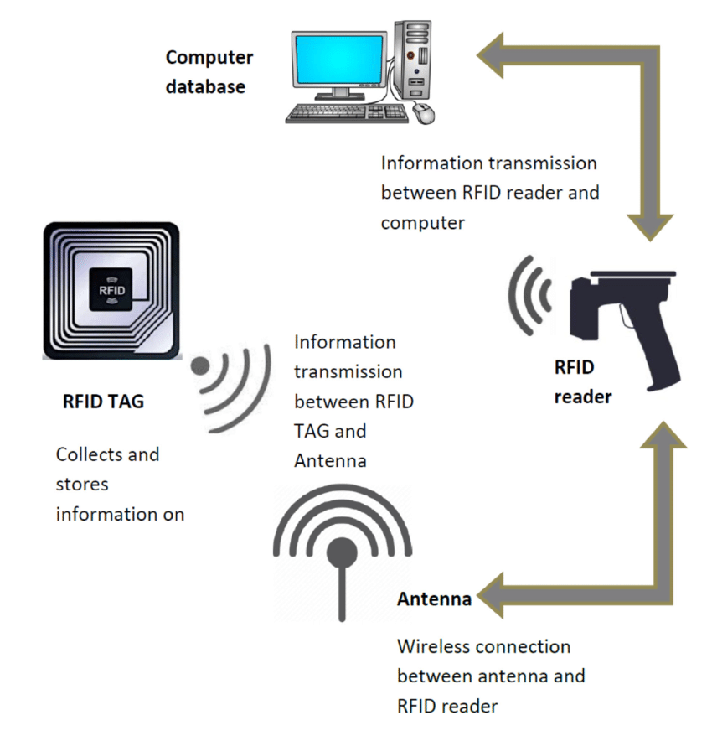
RFID Workflow

Slide 3
Introduction
The RFID reader is a network-connected device that can be portable or permanently attached. It uses radio waves to transmit signals that activate the tag. Once activated, the tag sends a wave back to the antenna, where it is translated into data. The transponder is in the RFID tag itself.

Slide 4
RFID Input
A DataWedge Profile contains four main components:
Input Plugin - determines how data should be acquired (e.g. barcode scanner)
Process Plugin (optional) - specifies how the acquired data should be manipulated
Output Plugin - controls the passing of data to an application
Associated Application/Activity - specifies the app/activity for the profile to be applied to

Slide 5
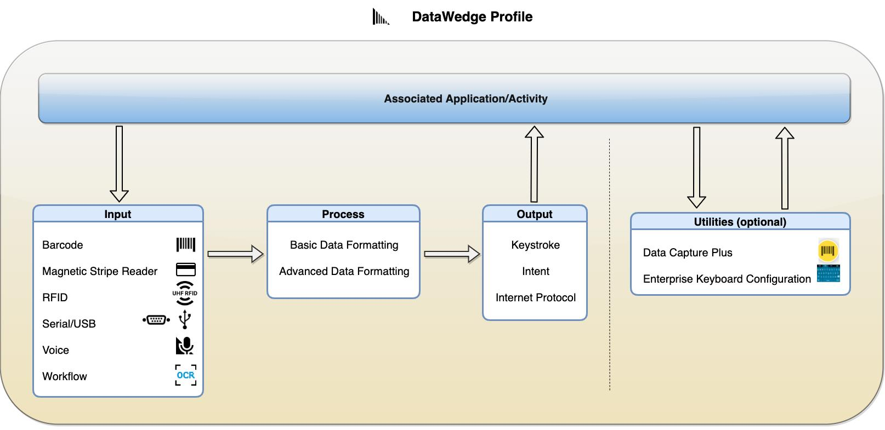
Two Inputs – RFID & Keyboard

Slide 6
How Does RFID Work?
RFID works by employing an RFID transponder (or tag) and a reader. The RFID transponder is comprised of a microchip that holds information to identify an object, product, or person and an antenna for transmitting this data to the reader.
The antenna transmits the data to a reader that converts the radio waves to usable information. Unlike bar code and magnetic stripe technology, RFID transponders can be read anywhere within the magnetic field sent out by the reader. Radio waves can travel and be read through many non-metallic objects. Depending on the power of the reader, an RFID antenna can be read from direct contact up to 20 feet.

Slide 7
What Is the Electronic Product Code (EPC) and EPCglobal?
Designed to be stored on an RFID tag, the Electronic Product Code (EPC) is a unique number that identifies a specific item in the supply chain. The EPC can be associated with dynamic data such as the origination point of an item or the date of its production.

